Slide 1

LIT-Book
Mukibi Deus Regno:2022-B072-20405
Nsubuga Charles Regno:2022-B072-20406​

Slide 2

About Lit-Book
It’s an application that allows our users to read and store books that the have read before to the comfort and in their hand for a convenient pick me up and read to serve the argues of imagination and entertainment

Slide 3

Problem
Market gap
Customers
Usability
New Customers need organizational tools, but are using old or outdated products for reading and enjoying there quality time.
10% increase of customer satisfaction and increase numbers of books read by our clients.
Customers want something that’s easy to adopt and simple to use
Costs
Loss of sales by not offering easier book management tools that push teams to the finish line for new users.

Slide 4
Solution
Close the gap
Target audience
Our product makes managing tasks easier, and no other product on the market offers the same benefits
Gen Z (18-30 years old)
Cost savings
Easy to use
Reduce costs for client by helping new users stay on target within deadlines of there choice
A simple product that gives Readers the information they need in order to complete there reading on time

Slide 5




Product Overview
Unique
First to market
Tested
Authentic
Only product specifically dedicated to Customer satisfaction. ​
First beautifully designed product that's both stylish and functional
Conducted testing with start ups in the area
Designed with the help and input of software experts

Slide 6

Product benefits
Simple and efficient to use​
Quick customer service assistance​

Slide 7
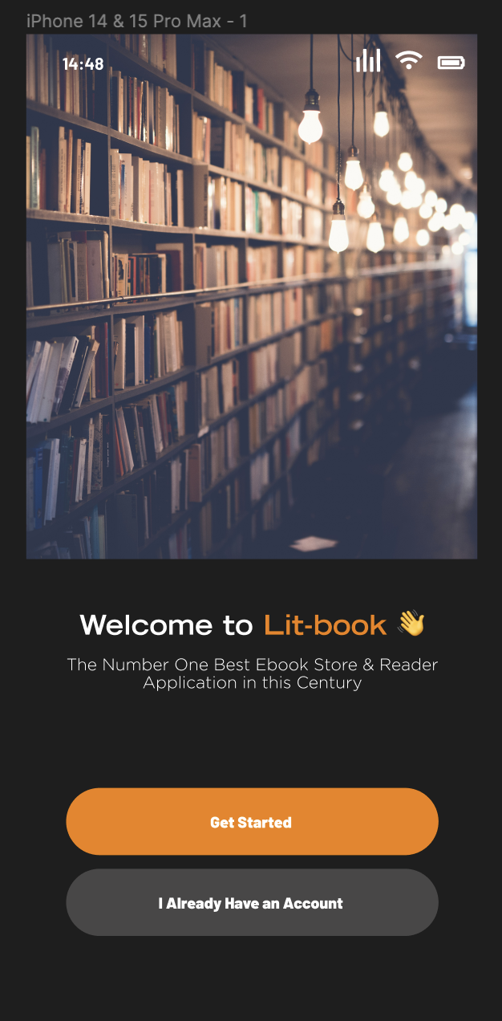
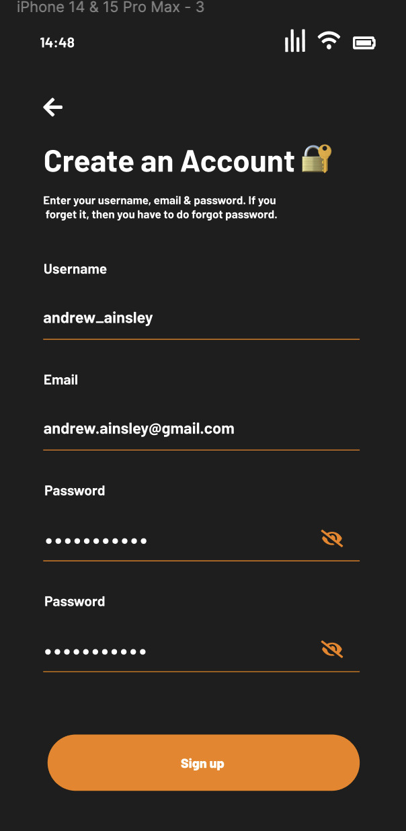
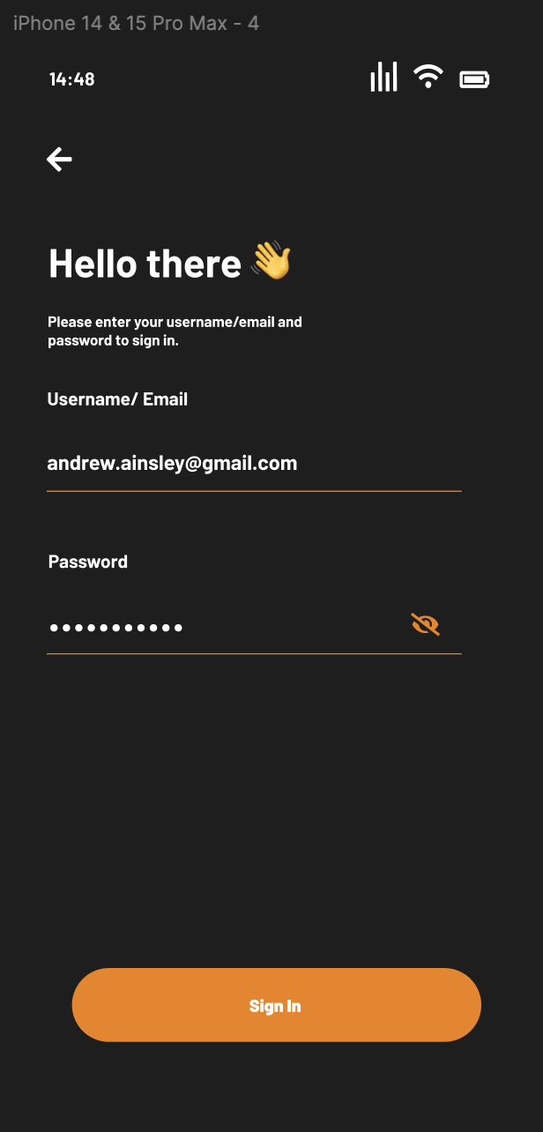
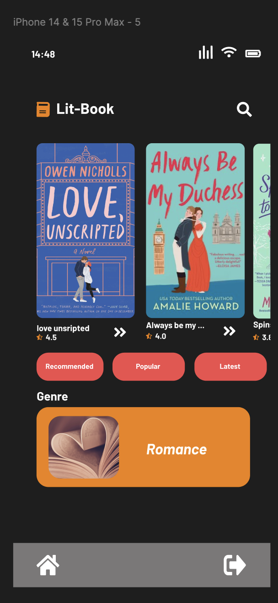
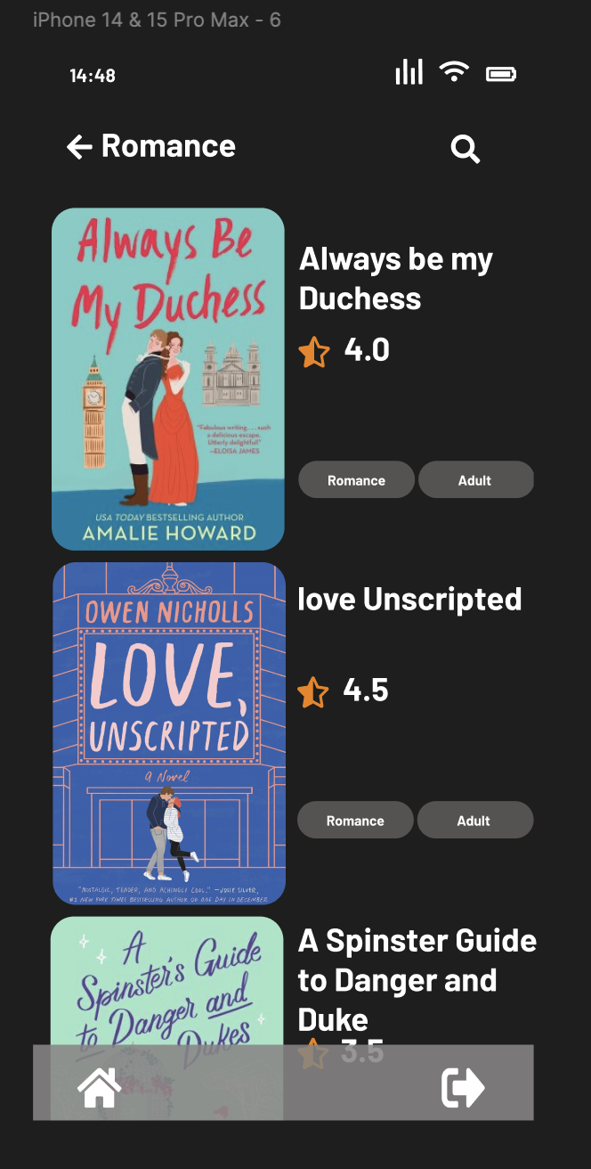
Designs for the project
Get Started page
Create account page
Login page
Home page
Romance genre view

Slide 8

Thank you
Mukibi Deus
Nsubuga Charles

